Slide 1
Effects of Smoking and Air Pollution on COPD By: Team RESPY
FPPT.com

Slide 2
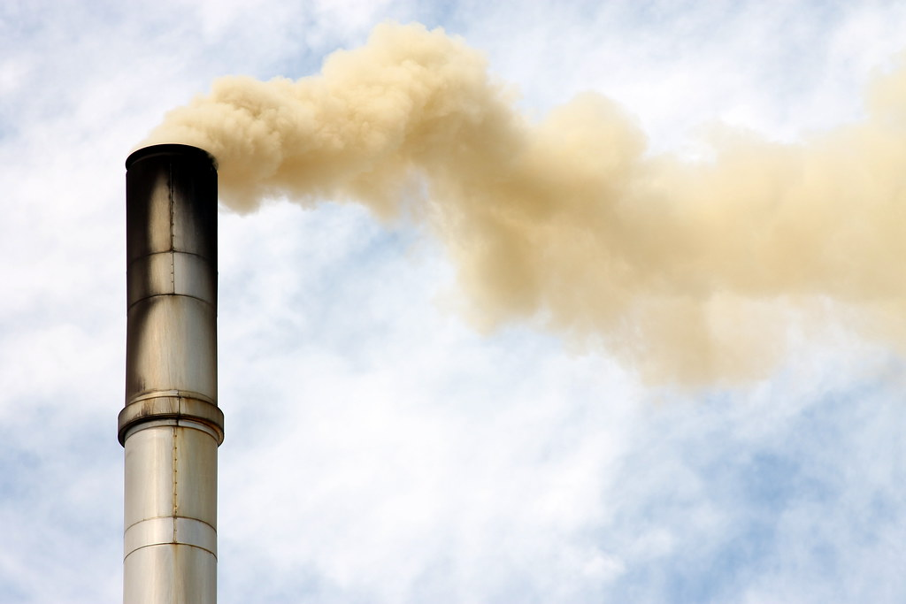
Index
Team Background/Role
Project Overview/Data Sources
Steps/Tools
Demo
Q&A

Slide 3

Meet the Team
TEAM RESPY
Krithika
Wilson
Wissemeddine
Raphael
Rishi

Slide 4
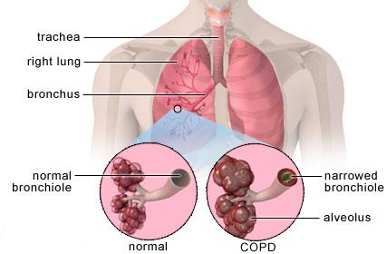
Project Overview
Visualizations of smoking data, air pollution, and COPD for users to explore the data themselves.
Tools Used: Python Flask, HTML, JavaScript, MongoDB.
Combination of Web Scraping and Leaflet

Slide 5


Steps
Find Data Sources: (https://www.lung.org/lung-health-and-diseases/lung-disease-lookup/copd/learn-about-copd/how-serious-is-copd.html, https://data.cdc.gov/Smoking-Tobacco-Use/BRFSS-Prevalence-and-Trends-Data-Tobacco-Use-Four-/ya9m-pyut/data, https://aqicn.org/api/)
Create Maps using D3 and leaflet as well as webscraping
Create html website using Python Flask
Use JavaScript to store records

Slide 6
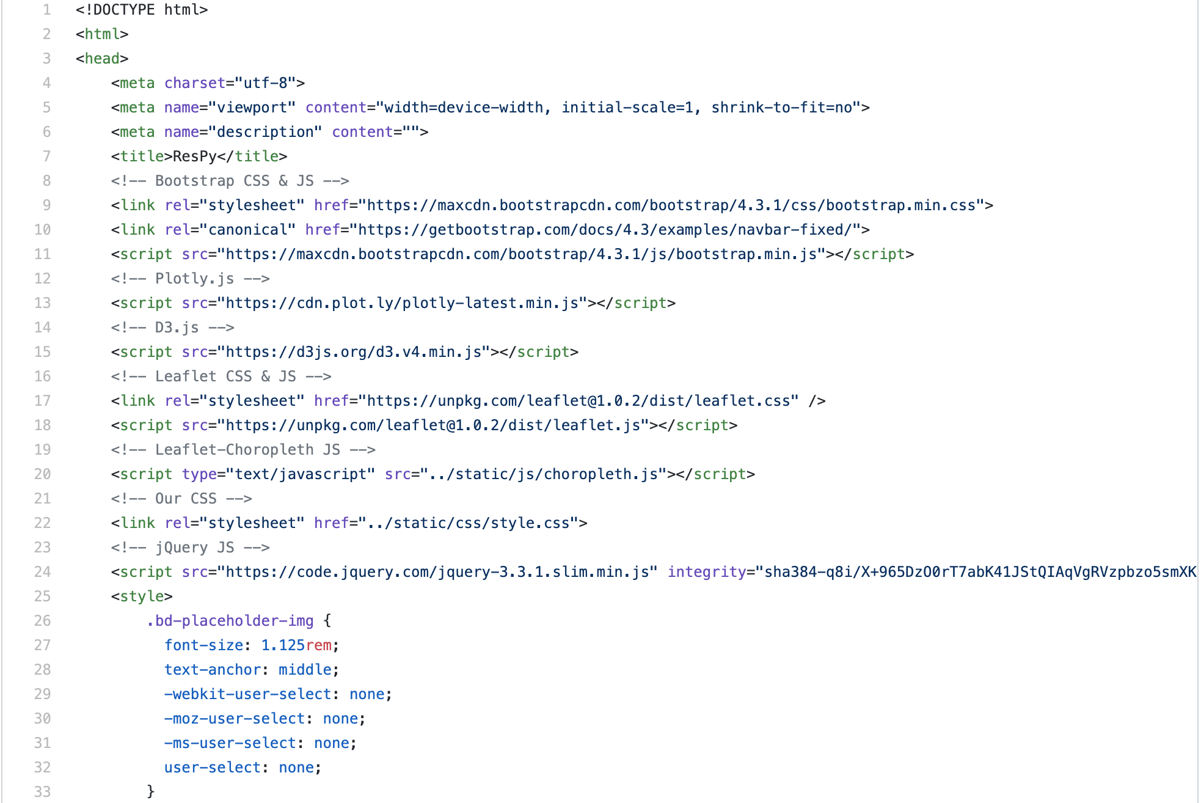
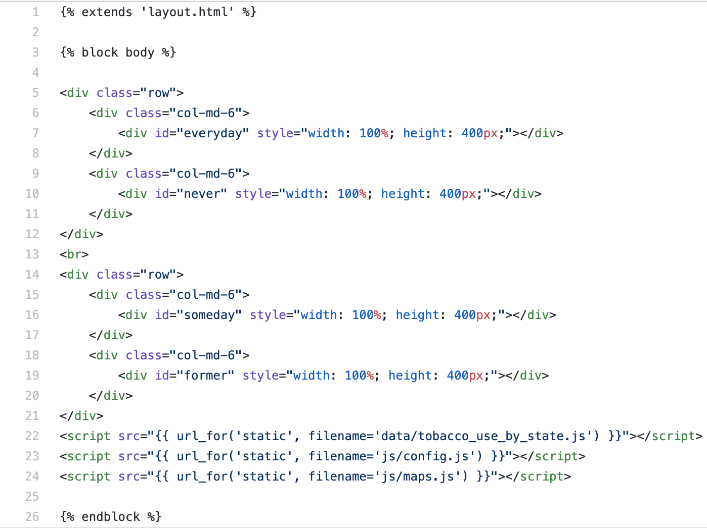
Demo
https://github.com/krithikaragha/ResPy

Slide 7

Project Considerations
Tool bar for local air pollution
Overlapping map for each data set
Multiple data sets (Last 10 years of data)
Life expectancy for each data set

Slide 8
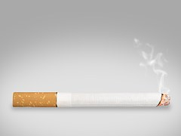
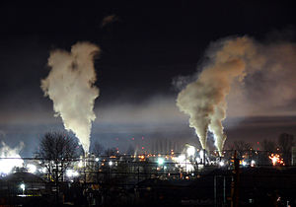
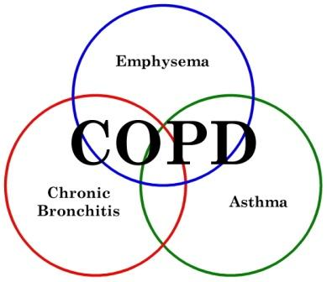
Q & A

